Slide 1
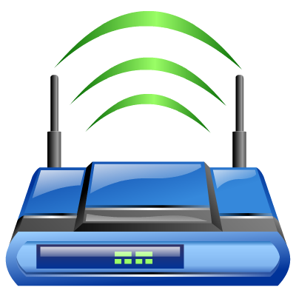
Virtual Router
https://virtualrouter.codeplex.com/
By :
Tamar Bash
Maor Taieb

Slide 2
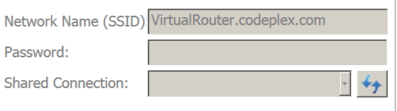
What is Virtual Router?
Virtual Router is a free, open source software based router for PCs running Windows 8, Windows 7 or Windows Server 2008 R2.
Using Virtual Router, users can wirelessly share any internet connection (Wifi, LAN, Cable Modem, Dial-up, Cellular, etc.) with any Wifi device (Laptop, Smart Phone, iPod Touch, iPhone, Android Phone, Zune, Netbook, wireless printer, etc.)
These devices connect to Virtual Router just like any other access point, and the connection is completely secured using WPA2 (the most secure wireless encryption.)

Slide 3
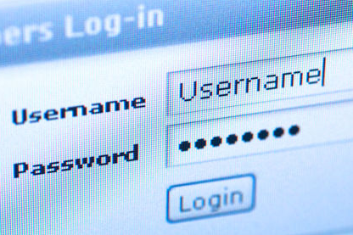
How it works ?
The Wireless Network create/shared with Virtual Router uses WPA2 Encryption, and there is not way to turn off that encryption. This is actually a feature of the Wireless Hosted Network API's built into Windows 7 and 2008 R2 to ensure the best security possible.
You can give your "virtual" wireless network any name you want, and also set the password to anything.
BTW, this project is written entirely in C#.

Slide 4
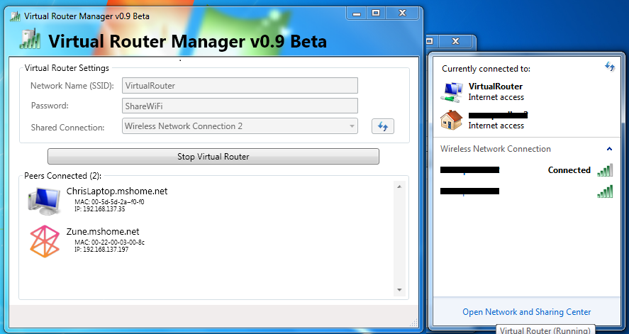
Demo

Slide 5
Modeling
In order to understand the modeling part we asked some questions:
What classes do we have?
What is the responsibility part of every class?
Which class is the “manager”?
What are the relations between the classes?

Slide 6
Modeling
In order to understand the modeling part we asked some questions:
What classes do we have?
What is the responsibility part of every class?
Which class is the “manager”?
What are the relations between the classes?

Slide 7
Modeling
Let’s present the different solutions:
ICS
WLAN
Client
Host
Host Console
Installer
service

Slide 8
Modeling
In order to understand the modeling part we asked some questions:
What classes do we have?
What is the responsibility part of every class?
Which class is the “manager”?
What are the relations between the classes?

Slide 9
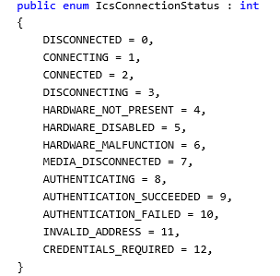
UML
Virtual router ICS
The ICS solution deal with the connection status.
Also the Process of creating new connection.

Slide 10
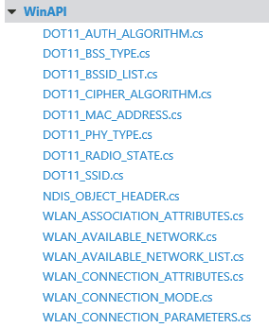
UML
Virtual router WLAN
The WLAN solution is basically includes all network issue and protocols such as Mac Address , connection mode , security …..

Slide 11
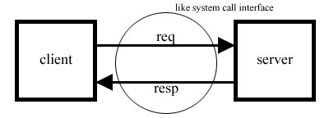
UML
Virtual router client
Since the solution works as Server Client platform we need usually to install client side.
Here we use the default way of client side to create connection .
The Client solution deal with the connection to the server.

Slide 12
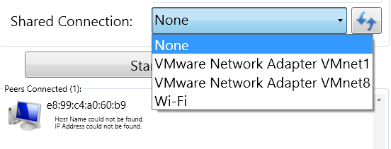
UML
Virtual router Host
This is the solution that turn the host wifi card to work as router.
Also take care of sharing issues , such as witch nic will do the Routing .

Slide 13
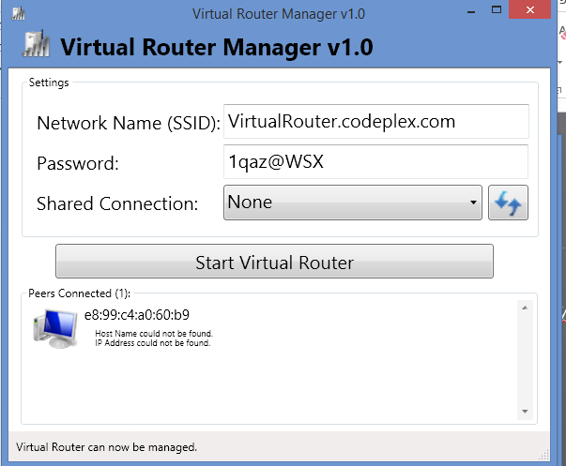
UML
Virtual router Host Console

Slide 14
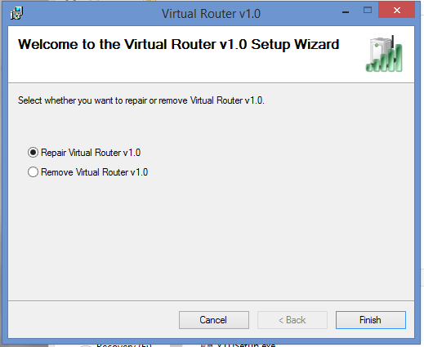
UML
Virtual router Installer
This solution contains the msi files , dlls that go onto registry ….

Slide 15
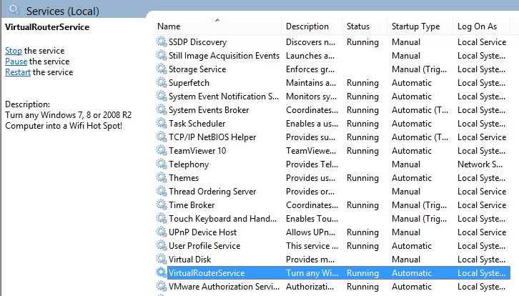
UML
Virtual router service
This solution gives the ability to work at background service .

Slide 16
Modeling
In order to understand the modeling part we asked some questions:
What classes do we have?
What is the responsibility part of every class?
Which class is the “manager”?
What are the relations between the classes?

Slide 17
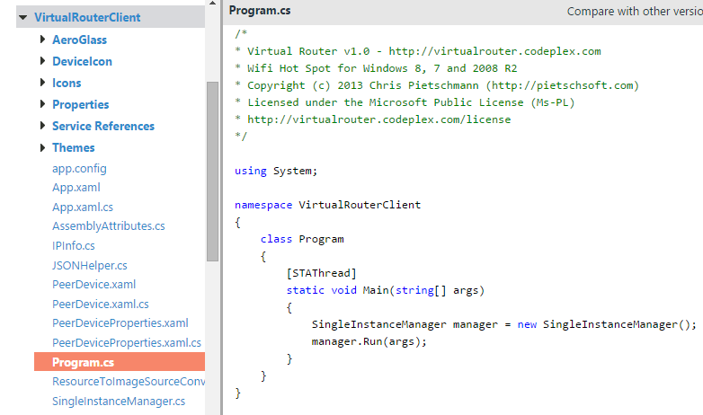
Modeling
The “manager” class is client.

Slide 18
Modeling
In order to understand the modeling part we asked some questions:
What classes do we have?
What is the responsibility part of every class?
Which class is the “manager”?
What are the relations between the classes?

Slide 19
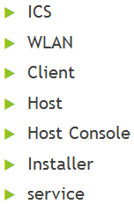
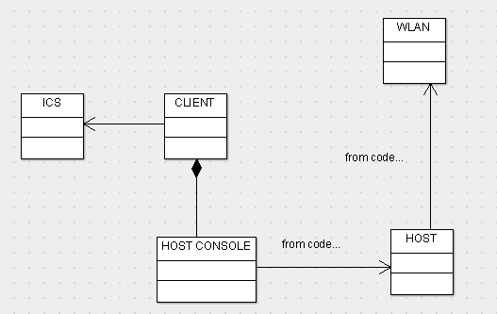
UML

Slide 20
Bugs & Tips
Error: "group or resource is not in the correct state to perform the requested operation"
Here's a Hotfix available from Microsoft for a common cause of this problem on Windows 7 and Windows Server 2008 R2: http://support.microsoft.com/kb/2496820 If the hotfix doesn't work, or you aren't using Windows 7 or 2008 R2, then you could try some of the suggestions at the following link: http://superuser.com/questions/373861/how-can-i-start-hostednetwork-on-windows-7
Support a large list of devices.
Money save .
High Secured Level.

Slide 21

Questions …

